Slide 1
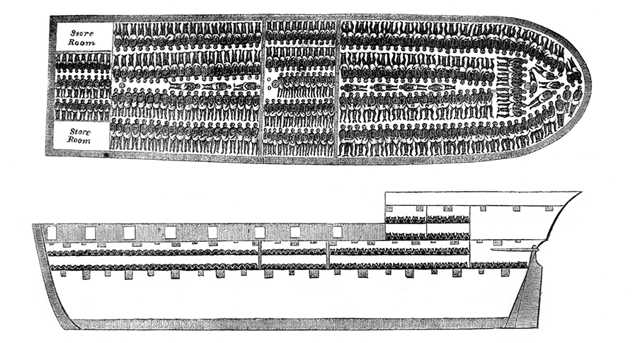
New Global Connections (1415-1796)
Lesson 5 The Slave Trade and Its Impact on Africa

Slide 2
New Global Connections (1415-1796)
Topic 5 Lesson 5 The Slave Trade and Its Impact on Africa
Key Terms
plantations
Afonso I
missionaries
Olaudah Equiano
triangular trade
Middle Passage
mutinies
Asante kingdom
Osei Tutu
monopoly
Oyo empire

Slide 3
New Global Connections (1415-1796)
Topic 5 Lesson 5 The Slave Trade and Its Impact on Africa
Learning Objectives
Summarize the expansion of the African slave trade.
Explain how triangular trade worked.
Understand the nature of the Middle Passage and describe its effects.
Analyze the impact of the Atlantic slave trade on West Africa and the Americas.

Slide 4
The African Slave Trade Expands
Slavery Throughout History
Slavery comes from the word Slavs, people who were often sold into slavery during the Middle Ages
European Traders Enter the Slave Trade
At first African slaves were considered as exotic servants for the rich. As colonies and plantations grew they turned to slave labor
African rulers and traders brought captives to the Europeans in exchange for weapons, gun powder, textiles, iron, other goods.
In the 1500’s the slave trade was small but over the next 300 years it will grow into a profitable business

Slide 5
The African Slave Trade Expands
African Resistance
Some African leaders will try to slow down or stop the trade but will fail
Afonso I, the ruler of Kongo, is a baptized Christian who asks for Portuguese help in developing his country. He wants to keep contact with Europeans but stop the slave trade. He will fail
In the late 1700’s another African ruler will try to stop the slave trade. The religious leader of Futa Toro will pass a law in 1788 not allowing anyone to transport slaves through his land to sell abroad. The slave traders just made a new route to the coast to sell the slaves

Slide 6
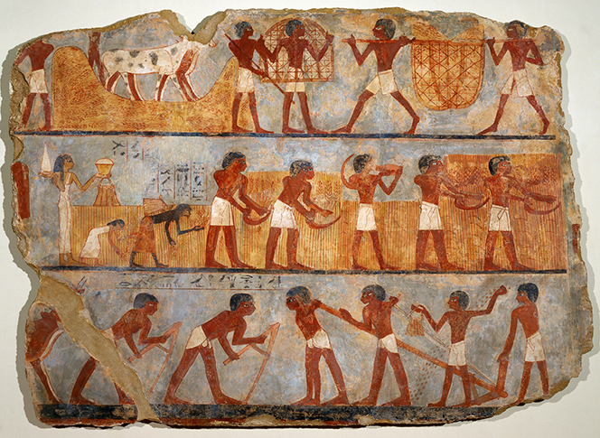
The African Slave Trade Expands
Slave labor was used in many civilizations of the past, including ancient Egypt, as shown in this image.

Slide 7
The Atlantic Slave Trade
Triangular Trade
First leg of the trade involved European merchants to bring their goods (guns, cloth, and cash) to Africa and trade these goods for slaves.
The second passage, the Middle Passage, slaves were transported to the Americas and exchanged for sugar, molasses, cotton, and other products
The third passage merchants carry sugar, molasses, cotton, furs, salt fish, rum to Europe where they were sold or traded for what merchants needed to return to Africa
Merchants, Industries, and Cities Thrive
The triangular trade will be very profitable for many people
Other industries not directly associated with slavery also became profitable like ship building, and fishing
European cities like Nantes (France), and Bristol (England) will grow prosperous and in North America Salem, and Newport also

Slide 8
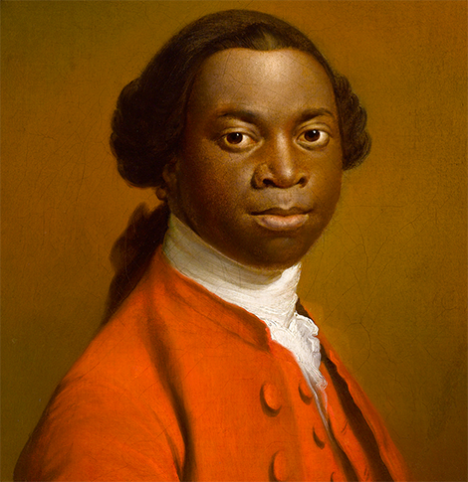
The Atlantic Slave Trade
Olaudah Equiano, shown in a 1780s portrait, was captured as a young boy in West Africa and sold into slavery. He later gained freedom and wrote an autobiography about his experiences.

Slide 9
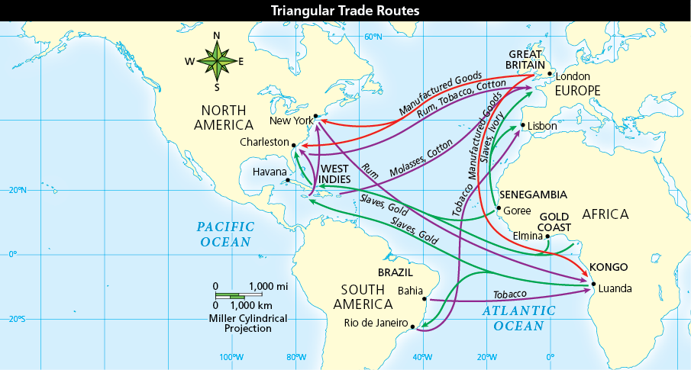
The Atlantic Slave Trade
Analyze Maps This map shows triangular trade routes that started in the 1500s. What trade goods were slaves exchanged for in North America?

Slide 10
Horrors of the Middle Passage
Forced March to the Ships
After Africans were enslaved they were forced to march to costal cities. They were bound by ropes and chains, often tied to one another, forced to carry heavy loads, and forced to walk up to one thousand miles to the coast.
Many died along the way, whoever escaped was recaptured and punished, and then they were taken to costal town in Ghana and Senegal where they awaited the Europeans in holding pens or warehouses.
Packed Aboard the “Floating Coffins”
After they were purchased hundreds of men, women, and children were packed into a vessel on a voyage that could last from 3 weeks to 3 months.
There were many perils on the sea like storms, pirates, mutinies, disease, brutal mistreatment. Many Africans killed themselves believing if they died they would return home

Slide 11
Horrors of the Middle Passage
Packed Aboard the “Floating Coffins”
Historians estimate that about two thousand Africans were sent to the Americas in the 1500’s
In the 1780’s the peak of the slave trade, that estimate is eighty thousand a year
By the mid 1800’s when slavery was finally ended it is estimated that 11 million Africans made it to the Americas and 2 million died on the way there
This will have a devastating effect on African societies

Slide 12
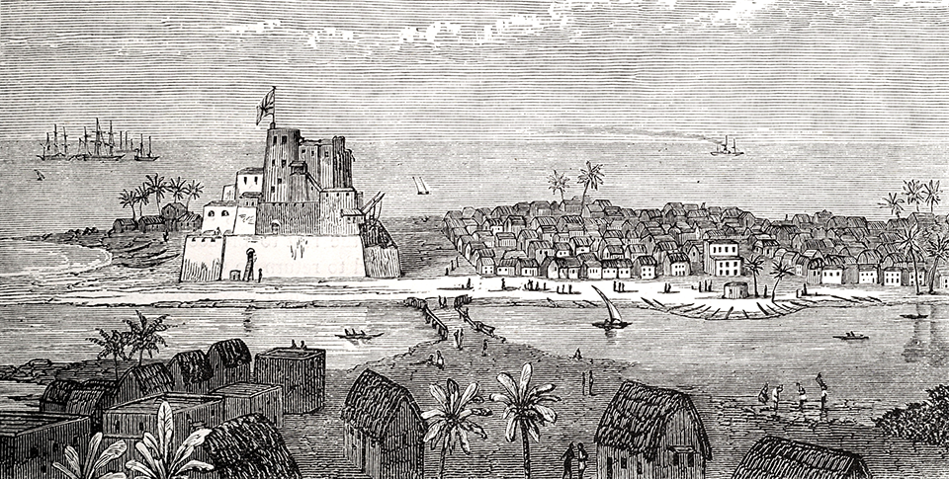
Horrors of the Middle Passage
Europeans built fortresses in ports along the west coast of Africa, such as the town of Elmina in what is now Ghana, shown here. Hypothesize What was one probable use of the fortress?

Slide 13
Impact of the Slave Trade
The Asante Kingdom
Osei Tutu will gain control of Kumasi, a trading city in Ghana. He will defeat the Denkyera, a powerful neighboring kingdom. He will create a royal monopoly on gold mining and slave trading. They will play European rivals against each other to protect themselves and build a wealthy, powerful state
The Oyo Empire
in the late 1600’s the Oyo Empire will use its wealth from the slave trade to build up its army in order to conquer a neighboring kingdom and will continue to trade with merchants
Slavery and the Americas
1807 the British will end slavery throughout its empire and in itself in 1833. in 1865 during the Civil War will the US end slavery
In 1888 Brazil will end slavery long after everyone else because of the sugar industry relied heavily on the slave trade.

Slide 14
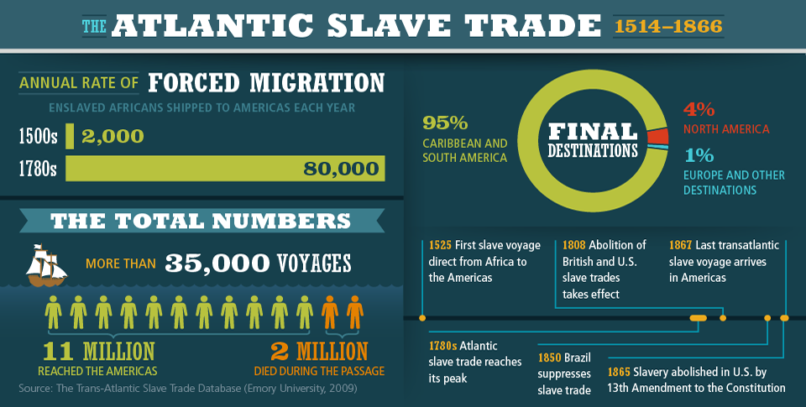
Impact of the Slave Trade
Analyze Charts Based on this information, what percentage of slaves died during passage to the Americas? Where in the Americas did most slaves end up?

Slide 15
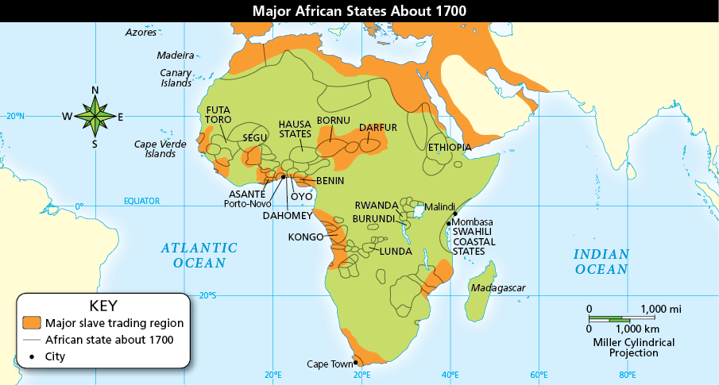
Impact of the Slave Trade
Analyze Maps Many African states were involved in or affected by the slave trade. In general, where were most slave trading regions located? Why?

Slide 16
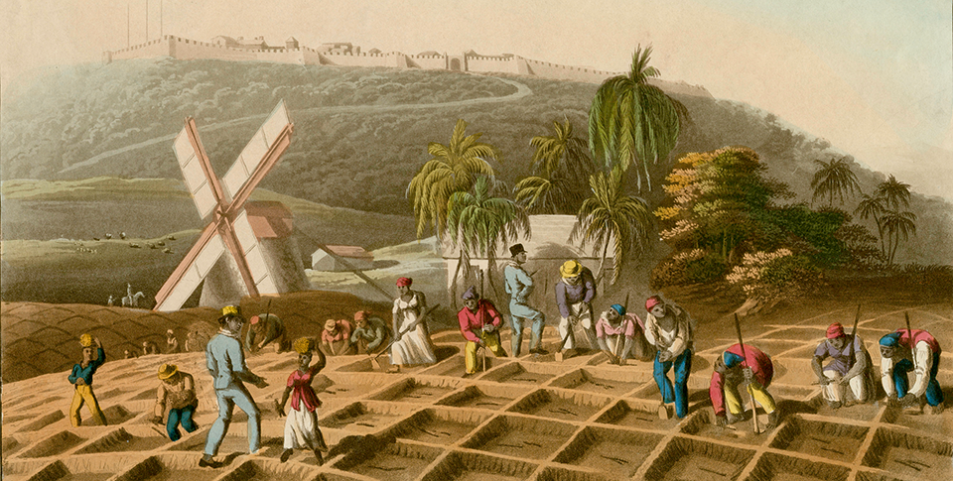
Impact of the Slave Trade
Slave laborers planted sugar cane on the West Indies island of Antigua.

Slide 17
Quiz: The African Slave Trade Expands
How did European exploration and expansion cause the African slave trade to expand?
A. European traders shipped enslaved Africans to work on plantations in European colonies in the Americas.
B. European explorers captured African people and forced them to work on their ships.
C. European explorers discovered the slave trade and expanded it across the Indian Ocean into South Asia.
D. Arab armies captured European explorers and forced them into slavery.

Slide 18
Quiz: The Atlantic Slave Trade
How did the Atlantic slave trade benefit the economy of Britain’s New England colonies?
A. Plantation owners were able to grow more crops.
B. New Englanders employed many slaves on their small farms.
C. New Englanders became wealthy by leading the anti-slavery movement.
D. New England’s shipbuilders earned profits by providing ships for the triangular trade.

Slide 19
Quiz: Horrors of the Middle Passage
Which of the following was the leading cause of the high death rate of enslaved Africans during the Middle Passage?
A. Many of the enslaved people died from dysentery, smallpox, and other diseases.
B. The slave traders’ ships often sank in the stormy waters of the Atlantic Ocean.
C. The crews of the slave ships murdered large numbers of the enslaved people.
D. Some enslaved Africans rebelled and were killed; many others committed suicide.

Slide 20
Quiz: Impact of the Slave Trade
Which of the following statements is TRUE?
A. European traders introduced the slave trade to Africa.
B. The slave trade harmed some African states, but benefited other African states.
C. The Asante kingdom used its growing power to end the slave trade in West Africa.
D. The slave trade devastated all the African states on Africa’s Atlantic coast.

